Slide 1
Natural Language Processing
Saravana

Slide 2

21st century
Evolution of Textual Data
Unstructured Data
Deriving High Quality information from Text
Using NLP we will turn the text into Data for Analysis

Slide 3
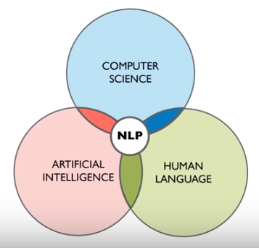
Natural Language Processing
Natural Language Processing, or NLP for short, is broadly defined as the automatic manipulation of natural language, like speech and text, by software

Slide 4
Applications of NLP
Speech Recognition
Chatbot
Machine Language Translation
Spell Check
Keyword Search
Information Extraction
Advertising Matching
Sentiment analysis
Document summarize
Topic identification

Slide 5
Natural Language Processing
A very well-known model in NLP is the Bag of Words model.
It is a model used to preprocess the texts to classify before fitting the classification algorithms on the observations containing the texts.
In this part, you will understand and learn how to:
Clean texts to prepare them for the Machine Learning models,
Create a Bag of Words model,
Apply Machine Learning models onto this Bag of Worlds model.

Slide 6
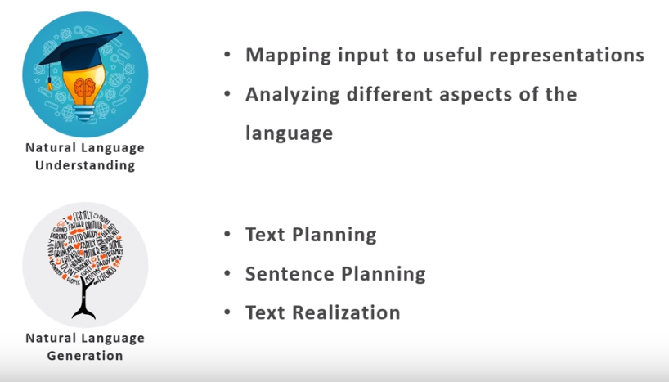
NLP: Components

Slide 7

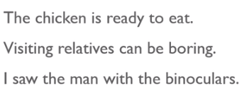
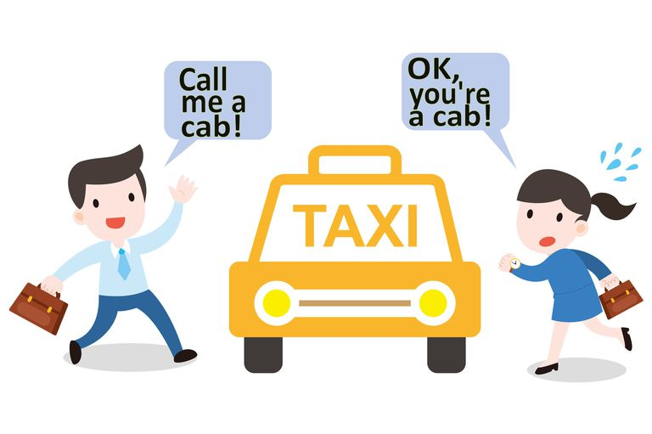

NLP: Ambiguity
Lexical Ambiguity
Syntactical Ambiguity: - two or more meaning for a sentence of couple of words
Reference Ambiguity: - Sometimes,

Slide 8
NLTK - Library
Tokenization
Stopwords
Bigram, Trigram, ngram
Stemming
Lemmatization
Parts of Speech
Named Entity Recognition
Count Vectorizer
TF-IDF Vectorizer

Slide 9
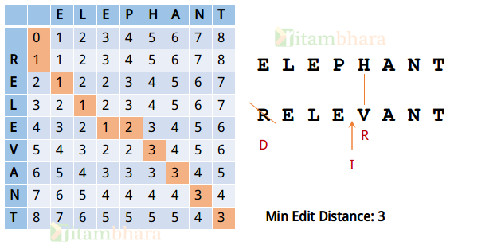
Minimum Edit Distance
Insert
Remove
Replace
Input: str1 = "sunday", str2 = "saturday" Output: 3 Last three and first characters are same. We basically need to convert "un" to "atur". This can be done using below three operations. Replace 'n' with 'r', insert t, insert a

Slide 10
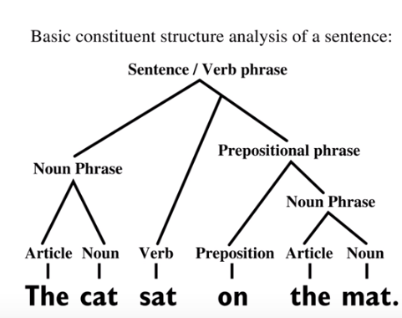
Syntax tree

Slide 11
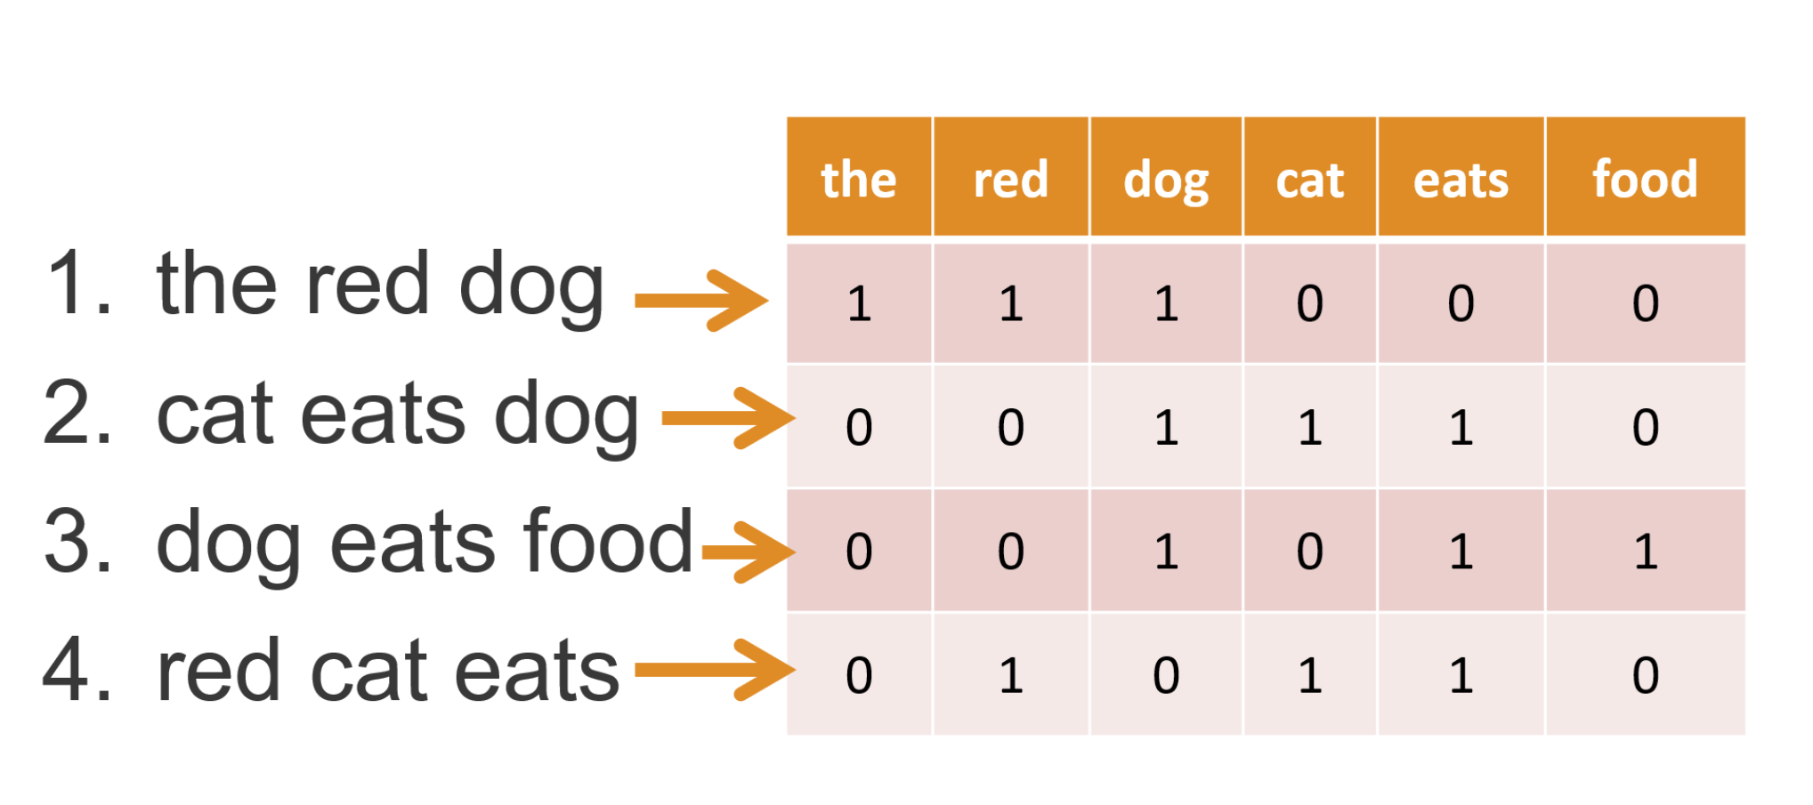
Count Vectorizer
https://scikit-learn.org/stable/modules/generated/sklearn.feature_extraction.text.CountVectorizer.html

Slide 12
TF-IDF Vectorizer
TF: Term Frequency, which measures how frequently a term occurs in a document. Since every document is different in length, it is possible that a term would appear much more times in long documents than shorter ones. Thus, the term frequency is often divided by the document length (aka. the total number of terms in the document) as a way of normalization:
TF(t) = (Number of times term t appears in a document) / (Total number of terms in the document).
IDF: Inverse Document Frequency, which measures how important a term is. While computing TF, all terms are considered equally important. However it is known that certain terms, such as "is", "of", and "that", may appear a lot of times but have little importance. Thus we need to weigh down the frequent terms while scale up the rare ones, by computing the following:
IDF(t) = log_e(Total number of documents / Number of documents with term t in it).

Slide 13
Thanks

